Slide 1
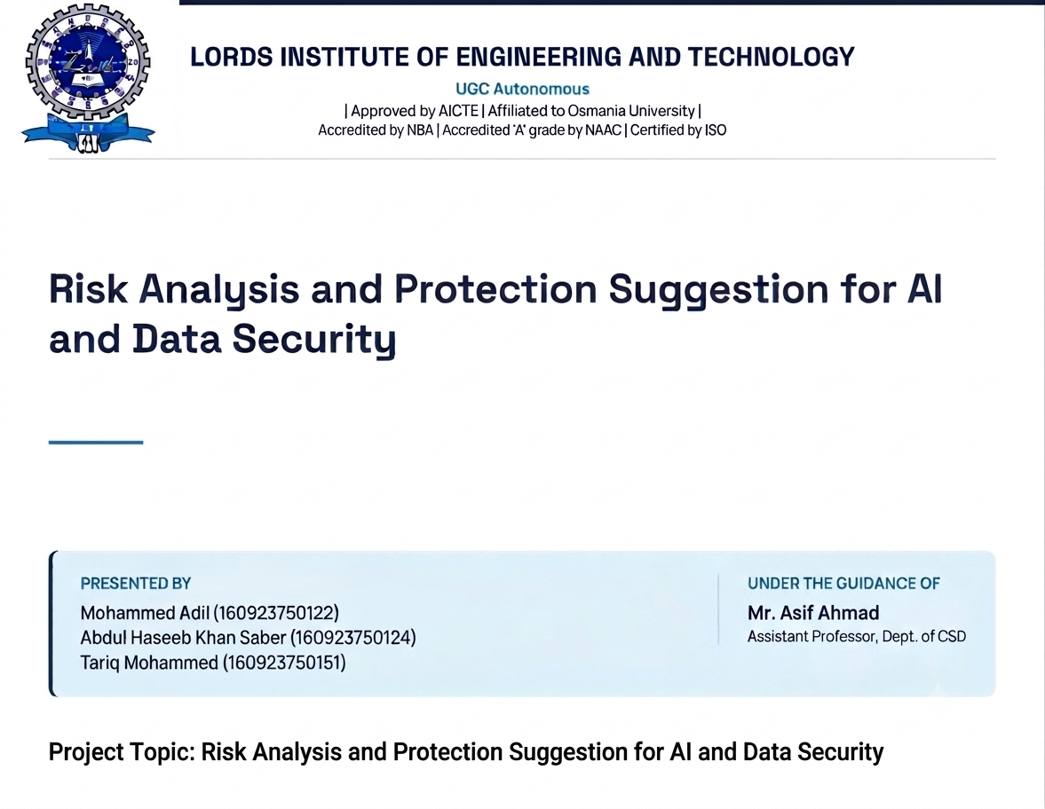
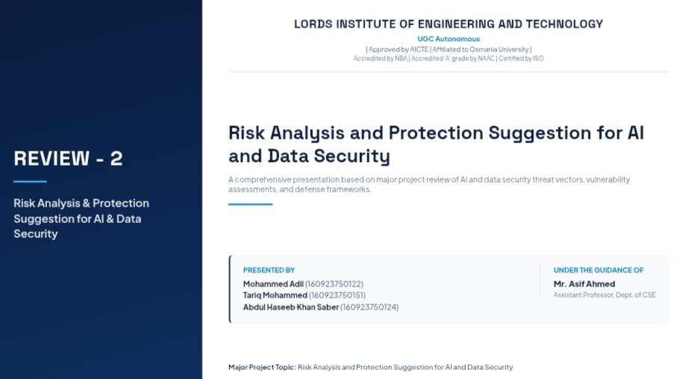
AI DATA SECURITY
Risk Analysis and Protection Suggestions for Artificial Intelligence Data Security
[College Name] | Department of CSD
Students: [Student Name 1], [Student Name 2], [Student Name 3]
Guide: [Guide Name]

Slide 2




Project Background
AI is a strategic technology, and its fast growth brings new security risks
Where AI is exposed
Regulation
Sensors, operating systems, control systems and device communications
Countries are creating policies for AI data security
Data in AI
The goal
Two stages to protect: model training and model output
Understand the risks and suggest ways to protect AI data
3

Slide 3

Problem Statement
Old security tools were not built for AI
1
2
3
Legacy security cannot see attacks aimed at AI models
No common standards across organisations and countries
AI attacks go unnoticed: poisoning, inversion, inference, adversarial
The result
AI systems in finance, infrastructure and decision-making stay exposed, and breaches are found only after the damage is done.
4

Slide 4






Existing System
Traditional cybersecurity applied to AI: perimeter defence, signature detection, static encryption
Reactive
Fragmented
No model monitoring
Problems are found only after a breach
Isolated tools and blind spots
Gradual manipulation goes undetected
Data leakage
Third-party risk
Low visibility
Model inversion rebuilds training data
Pre-trained and open-source models unchecked
Deep models are hard to investigate
5

Slide 5






Proposed System
One multi-layered framework that protects AI across its whole lifecycle
Data integrity
Threat detection
Differential privacy
Cryptographic tracking stops data poisoning
Real-time watch on model inputs and outputs
Individuals cannot be identified from the model
Federated learning
Compliance
Incident playbook
Train on distributed data without centralising
EU AI Act, NIST AI RMF, ISO/IEC 27001
Fast, step-by-step response to AI attacks
6

Slide 6






Objectives
Identify the data security risks of AI systems
Verify integrity of training data and models
Detect AI-specific attacks in real time
Protect privacy in training and outputs
Meet national and international regulations
Shift security from reactive to proactive
7

Slide 7






Methodology
A security checkpoint at every stage of the AI pipeline
Collect
>
Preprocess
>
Train
>
Validate
>
Deploy
>
Monitor
Verify the data source
Scan for poisoning
Add privacy noise
Test against attacks
Sign and version the model
Detect and respond
Always on: audit logs, risk scoring and compliance reports across all six stages
9

Slide 8




Technologies
Techniques and standards used in the framework
Privacy
Detection
Trust & integrity
Differential privacy, federated learning, secure multi-party computation
ML anomaly detection, live threat intelligence feeds
Cryptographic hashing, signed model registry, chained logs
Explainability
Access & operations
Standards
SHAP and LIME for readable model decisions
Role-based access, multi-factor authentication, SIEM, DevSecOps
EU AI Act, NIST AI RMF, ISO/IEC 27001, GDPR
10

Slide 9
Results
What the framework achieves, in simple terms
Full coverage
Bad data caught
Privacy kept
Protects data, models, users and logs
Spots tampered training data early
No one can be identified from the model
Live detection
Rules followed
Quick response
Watches model inputs and outputs for attacks
Meets EU AI Act, NIST and ISO standards
Clear steps to act when an attack happens
11

Slide 10
Future Scope
Test AI models by attacking them first
Protect chatbots and generative AI too
Train with more partners without sharing data
Use stronger encryption methods
Keep up with new AI laws
Try it in real companies
12

Slide 11

Security for every AI system
Protect the data, verify the model, monitor continuously.
Thank you .

